Slide 1




Module Name - Inheritance & Polymorphism
Class - Day 3
Topic Name- Inheritance
EditEdit MasterMaster texttext stylesstyles

Slide 2
Time Allocation Summary
Element | Slide numbers | Maximum time allowed (min)
Today’s Agenda | 4-5
Spot Test | 6-7
The Second Principle of OOPs: Encapsulation | 8-12
Code Reusability | 13-15
OOPs: Last Two Principles | 16
Introduction to Inheritance | 17-21
Inheritance: Example | 22-28
Inheritance in Java | 29-33
Flow of Inheritance | 34-37
Constructor Chaining | 38-42
Disadvantages of Inheritance | 43-44
Multiple Inheritance | 45-46

Slide 3
Time Allocation Summary
Element | Slide numbers | Maximum time allowed (min)
Inheriting from Subclass | 47-54
Protected Access Modifier | 55-60
Composition | 61-63
Inheritance vs Composition | 64-66
Composition: Example | 67-69
Summary | 70-72
Total Time |  | 120

Slide 4
Today’s Agenda
Need for Code Reusability
Introduction to Inheritance
Flow of Inheritance
Inheritance in Java
Constructor Chaining
Disadvantages of Inheritance
Multiple Inheritance

Slide 5
Today’s Agenda
Inheriting from a Subclass
Protected Access Modifier
Introduction to Composition
Comparison between Composition and Inheritance

Slide 6
Spot Test
How many classes are allowed to be made in a Java File?
What is an object?
How is object declared for a class? Which Operator is used? Give complete syntax.
Can multiple objects be created for a class?

Slide 7
Spot Test
What happens when a method is declared as final?
What is the use of static keyword?
What is the difference between parameterized and default constructors?
Can a variable be declared as both static as well as final?

Slide 8

The Second Principle of OOPs: Encapsulation
What is encapsulation?
Encapsulation is a principle based on hiding
the state of objects and restricting their
access to various parts of your program.
Encapsulation is achieved with the use of
private access modifiers and the getter and
setter methods.

Slide 9

The Second Principle of OOPs: Encapsulation
How do you create a fully encapsulated class?
Make all the instance variables of a class
private.
Only use getter and setter methods to
read or write values of the instance
variables.

Slide 10


The Second Principle of OOPs: Encapsulation
Advantages of encapsulation
You can make your class read-only or
write-only by declaring only getter or
setter methods.
This prevents other code or malicious code from accessing instance variables in your class that they should not read or modify.

Slide 11
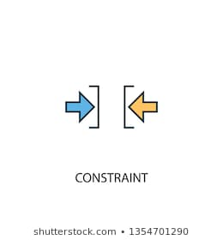
The Second Principle of OOPs: Encapsulation
You can add variable logic/constraints in
the setter methods, so you have full control
of the data that can be assigned to the
instance variables.

Slide 12
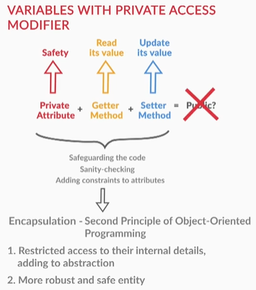
The Second Principle of OOPs: Encapsulation
Encapsulation
Notes:
Student class Demonstration example to be explained for more deep illustration

Slide 13

Code Reusability
You already know that reusability of code is required lots of time in the code to make it less time
consuming and less hectic for the coder.
One of the vital benefit of object-oriented
programming is code reusability.

Slide 14
Code Reusability
Why code reusability?
The rising cost of building large software systems can be attributed to the fact that most of the development takes place from scratch.
But by using the object-oriented programming methodology, large systems are built via modules that have been created earlier rather than by rewriting the code for the entire software from scratch.

Slide 15

Code Reusability
The two main benefits of code reusability are:
It saves on development effort and, in turn, reduces the overall development cost of the software.
It makes system maintenance easier. This
is because only the new module will have
to be tested for errors, not the entire
program.

Slide 16
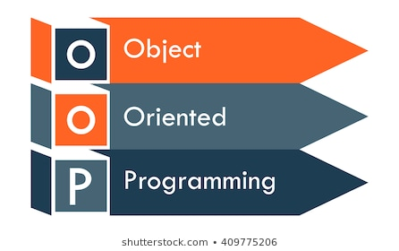
OOPs: Last Two Principles
Object-oriented programming provides these benefits through its last two principles:
Inheritance
Polymorphism

Slide 17

Introduction to Inheritance
What is Inheritance?
In object-oriented programming, inheritance provides a means by which an object of one class can use the
properties of an object of another class.
Instead of using duplicate code i.e writing same
code again and again, the code is reused using
inheritance.

Slide 18

Introduction to Inheritance
Why Inheritance?
Duplicate code is not good because if there is a small error in it we have to go through every part
where the duplicate code is written.
Moreover, writing a similar kind of code for
multiple different scenarios makes the code redundant and unreadable.

Slide 19
Introduction to Inheritance
Rather than writing the same code, again and again, the concept of inheritance is introduced.
With the help of inheritance, multiple classes can share a common set of methods and attributes.
These common set of methods and attributes can be reused in multiple classes thereby, helping to reduce the code redundancy.

Slide 20
Introduction to Inheritance
What does Inheritance imply?
A class can define certain behaviours that can be used later by new classes, instead of redefining the same functionalities again in the new classes.
A class that contains common functionalities for
other classes to inherit is called a superclass,
base class or parent class.
SUPERCLASS
SUBCLASS

Slide 21
Introduction to Inheritance
A class that inherits from a superclass is called a subclass, derived class or child class.
A child class — apart from inheriting the properties of a superclass — can have its own additional properties in the form of its own methods and variables.
Hence, a subclass can also be considered as a specialised version of a superclass.

Slide 22

Inheritance: Example
Suppose, you have to develop an information management system for a college. So, you added a class named student in your code. The Student class contains:
Variables for name, year and annual fees of students.
Constructor to initialize name and year.
Method to get the details of student(name
& fees).
Method to compute the fees.
Notes:
Code can be shown

Slide 23
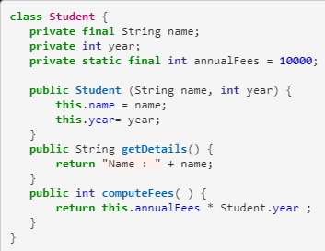
Inheritance: Example
Notes:
Code can be shown

Slide 24

Inheritance: Example
Now, you want to widen the information system by creating a class for the students who are in research department. The class ResearchStudent contains:
All the variables and methods that are
their in Student class.
An extra variable for area of Research.
Constructor to initialize name, year as well as researchArea.
Notes:
Code can be shown

Slide 25
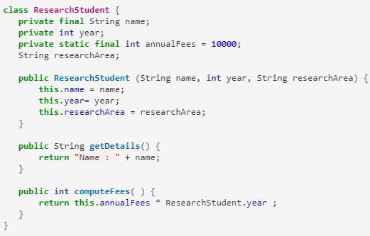
Inheritance: Example
Notes:
Code can be shown

Slide 26

Inheritance: Example
You can observe that there is a very high degree of similarity in both the classes. So, there is a scope for code reusability in this information management system.
Thereby, inheritance can be used here.

Slide 27
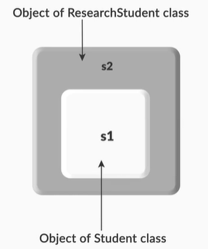
Inheritance: Example
You can observe that ResearchStudent class has removed all the methods and variables that are
common in both the classes.
It is inheriting properties from Student
class. So, the object of ResearchStudent can
access these properties of the Student class.
Hence, there is no need to write the
common methods and variables again.

Slide 28
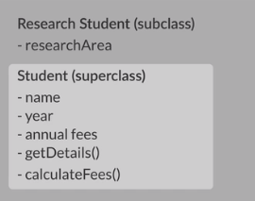
Inheritance: Example

Slide 29
Inheritance in Java
Inheritance in Java
A subclass can inherit features from a superclass using the keyword ‘extends’.
So, if a class Square wants to inherit from a
class Rectangle (Square is a type of Rectangle),
Rectangle is the superclass and Square is the
subclass, and Square has inherited all features
of Rectangle class.
SUPERCLASS
SUBCLASS

Slide 30

Inheritance in Java
The syntax of writing this will be:
public class Square extends Rectangle {
// class definition of Square
}

Slide 31
Inheritance in Java
Every class in Java automatically extends the Object class.
Thus, by default, the Object class acts as the superclass for all the classes in Java.
Note: Since a subclass will inherit all the features of its superclass, except its constructor, it must often invoke the superclass constructor for the initialisation of the superclass members. This is done using the keyword super in the constructor of the derived class.

Slide 32
Inheritance in Java
If a subclass constructor does not explicitly call the superclass constructor, then the default constructor of the superclass is implicitly invoked by the compiler.
If a superclass constructor is called using the keyword super, then this must be the first statement in the derived class constructor.

Slide 33
Inheritance in Java
Example of how you can call a superclass constructor from a base class:
public class Square extends Rectangle {
Square(argumentsList) { // constructor for the class Square
super(argumentsList); // calling the constructor of the
} superclass Rectangle
}

Slide 34
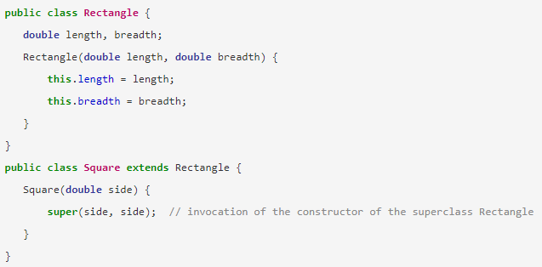
Flow of Inheritance
Flow of Inheritance: Example

Slide 35
Flow of Inheritance
Flow of Inheritance:
In this example, the Square class inherits the Rectangle class.
When an object of the Square class is created,
the constructor of the Square class is invoked.
Inside the definition of the constructor of the
Square class, the super() method is invoked.
SUPERCLASS
SUBCLASS

Slide 36

Flow of Inheritance
The super() method will call the superclass constructor, thus invoking the constructor of the Rectangle class.
Thus, you can conclude that when an
object of a subclass is created, the
constructor of the subclass is invoked first
and then the constructor of the
superclass is invoked.

Slide 37

Flow of Inheritance
In this case, since the superclass Rectangle has a parameterised constructor, the subclass constructor must explicitly invoke the constructor for the Rectangle class in its own constructor.
Failure to do so will result in a compilation error.

Slide 38
Constructor Chaining
What is constructor chaining?
When a subclass constructor calls the superclass constructor, this phenomenon is known as constructor chaining.
Apart from calling the constructor of the superclass, ‘super’ is also used to refer to the instance variables of a superclass.

Slide 39

Constructor Chaining
Example: super.instanceVariable - Here, instanceVariable belongs to the superclass.
public class Square extends Rectangle {
super.length; // refers to the length attribute
defined in the Rectangle class
}

Slide 40

Constructor Chaining
When an object of the subclass is created it contains the superclass variables but it doesn’t create any superclass object in it.
When subclass object has created the constructor
of the superclass is executed but this doesn’t mean
that superclass object is created.
Let us observe a code and an output to understand this.

Slide 41
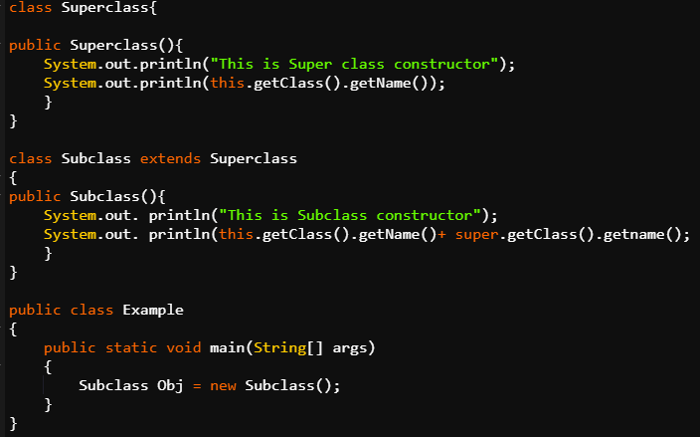
Constructor Chaining

Slide 42

Constructor Chaining
Output
This is Super class constructor
Subclass
This is Subclass constructor
Subclass Subclass
Both constructors are executed.

Slide 43

Disadvantages of Inheritance
Disadvantages of Inheritance
Sometimes, inheritance is not useful because the data members and methods in the base class cannot be utilized to the fullest.
At times, some of these members are left
unused thereby resulting in wastage of
memory.

Slide 44
Disadvantages of Inheritance
The inherited methods work slower than the normal methods due to the presence of indirection.
Inheritance leads to the dependency of children classes on the base class thereby resulting in an increase in coupling.

Slide 45
Multiple Inheritance
Multiple Inheritance
Java doesn’t support multiple inheritance because, consider a scenario where A, B and C are three classes. The C class inherits A and B classes.
If A and B classes have the same method
and you call it from child class object, there
will be ambiguity to call the method of A or B class.
A
B
C

Slide 46
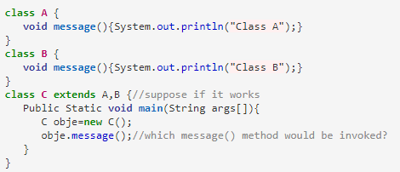
Multiple Inheritance

Slide 47
Inheriting from Subclass
So far, you created two classes: Student and ResearchStudent. Here, ResearchStudent extends Student.
How about a situation where another class inherits
from the ResearchStudent class?
?
STUDENT
RESEARCH
STUDENT

Slide 48
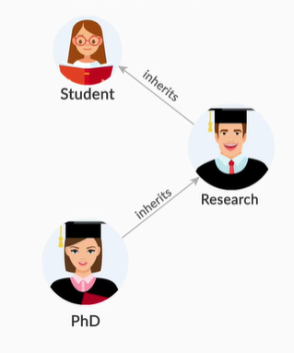
Inheriting from Subclass
Suppose you want to create a class for
PHD students which basically come
under the category of Research
department only.
Will it be even possible for another class
to inherit from the ResearchStudent
class, given that it is already a subclass
of Student?

Slide 49

Inheriting from Subclass
Inheriting from Subclass

Slide 50

Inheriting from Subclass
So,it is possible to inherit from a subclass.
Class PhdStudent has its own private variable
thesisTitle.
It is initialized in the constructor.
Other than that, this class is inheriting properties from class ResearchStudent which itself is a subclass of class Student.

Slide 51
Inheriting from Subclass
Let's take another example to understand this better. Let’s say the class Rectangle extends from a class named
‘Shape’ (Rectangle is a shape, and hence, Shape can
act as a superclass for it), and the class Square
extends the class Rectangle.
public class Shape{ }
public class Rectangle extends Shape{ }
public class Square extends Rectangle{ }
SHAPE
RECTANGLE
SQUARE

Slide 52
Inheriting from Subclass
Since the subclass Rectangle inherits from the superclass Shape, Rectangle will be able to reuse all the properties of the Shape class.
Thus, a subclass object can access the properties of a superclass but the vice-versa is not true meaning that a superclass object cannot access the properties of a subclass.

Slide 53
Inheriting from Subclass
Also,since the subclass Square inherits from the Rectangle class, the ﻿Square class will be able to reuse the properties of the Rectangle class.
In addition, the Square class will also inherit additional attributes from the Shape class via the Rectangle class.
Thus, a subclass object can access the properties of a superclass - no matter whether it's a direct parent or an indirect parent but the vice-versa is not true.

Slide 54
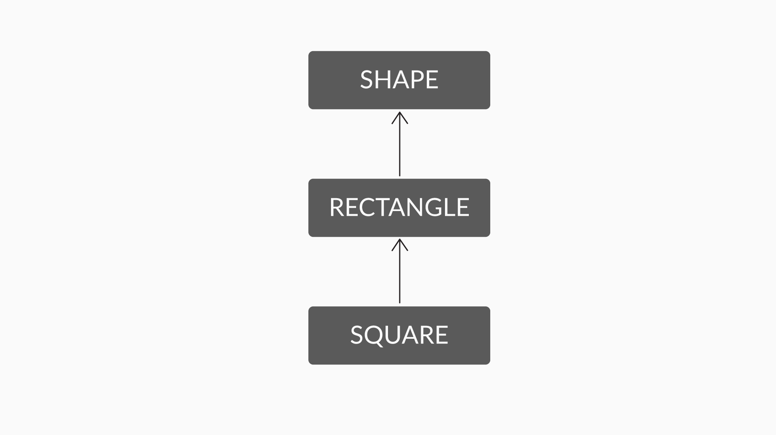
Inheriting from Subclass
Inheriting from Subclass

Slide 55

Protected Access Modifier
You have already studied about two access modifiers - public and private.
Let's now get introduced to the third type
of access modifier - protected.

Slide 56

Protected Access Modifier
Protected Access Modifier
It is an access modifier which is less restrictive than private but more restrictive than public. Variables, methods, and constructors, which are declared protected in a superclass can be accessed only by the subclasses in other package or any class within the package of the protected members class.
A variable is declared protected
like this

Slide 57

Protected Access Modifier
Let us take an example to understand better.
Any method from within the Square class won’t be able to access Rectangle’s private attributes or methods directly.
This may be fine sometimes; but at other
times, it may be too restrictive.

Slide 58
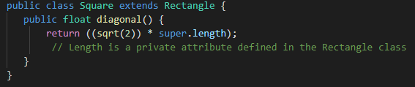
Protected Access Modifier
For example, suppose the Square class wants to access the length attribute declared in the Rectangle class for calculating the diagonal of a square.

Slide 59

Protected Access Modifier
If this is added to the Square class, it will
lead to a compilation error.
This is because ‘length’ is a private
variable in the Rectangle class, and the
private variables or methods of a class are
not accessible outside the class.

Slide 60
Protected Access Modifier
In order to extend the visibility of the length attribute only to the subclasses for direct access, you can use the protected access modifier in the Rectangle class, such as:
protected float length;
This would make the variable length visible and accessible to all of subclasses of the Rectangle class but not to any other classes that don't inherit from the Rectangle class.

Slide 61

Composition
Now, suppose you want to create another class named BankAccount. This class will have variables for account number and balance and a constructor to initialize both the variables.

Slide 62
Composition
It does not make sense for this class to be a subclass of any of the previous classes: Student, ResearchStudent or PhdStudent.
This is because bank account is not a form of student. It is something which every student must have.
So, it shouldn’t be a subclass but since every student must have a bank account therefore some relationship has to be there between Student Class and BankAccount class.

Slide 63

Composition
This is where Composition comes into play. Composition is a kind of relationship between two classes. It is considered as a has-a type of relationship between two classes. On the other hand, inheritance is of is-a type.
This means that one of the class contains an attribute which is of the type of other class.
Like, here, Student
class will have an attribute of the type Bank Account.

Slide 64
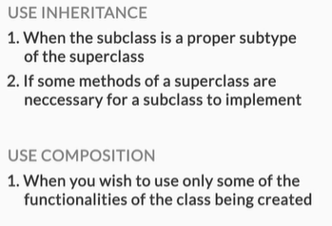
Inheritance vs Composition
Inheritance vs Composition

Slide 65


Inheritance vs Composition
Some reasons to use composition over inheritance are:
One reason for favouring Composition over Inheritance in Java is fact that Java doesn't support multiple inheritance.
Though both Composition and Inheritance
allows you to reuse code, one of the
disadvantages of Inheritance is that it breaks
encapsulation.

Slide 66

Inheritance vs Composition
If the subclass is depending on superclass behaviour for its operation, it suddenly becomes fragile.
When the behaviour of superclass changes,
functionality in the subclass may get broken,
without any change on its part.
Composition offers better test-ability of a class than Inheritance.

Slide 67
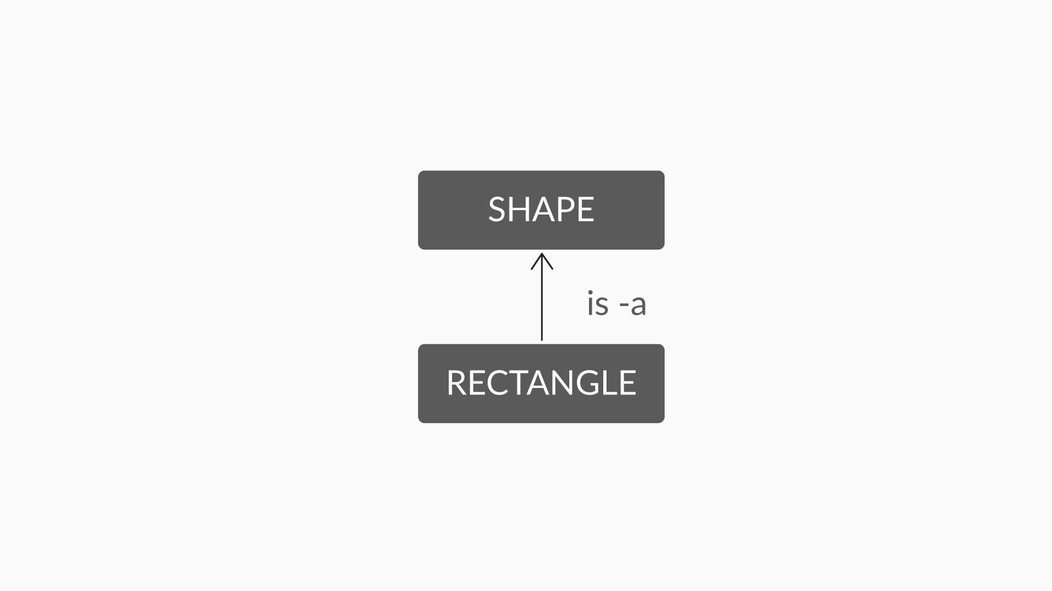
Composition: Example
Let’s see the relationship b/w Shape class and a Rectangle class
Now you know that shapes have some dimension. In this case, you can represent the dimensions of a shape with the help of a Dimension class.

Slide 68
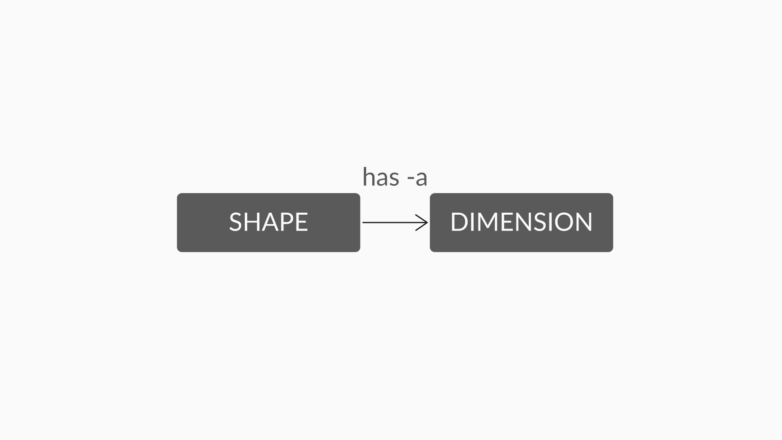
Composition: Example
So now, the relationship between the Shape class and the Dimension class can be represented as follows:

Slide 69
Composition: Example
So, in the case of the Shape and Dimension classes, the composition relationship in a Java code will look like this:
public class Shape {
Dimension dimension;
}
The statement ‘Dimension dimension;’ creates an object of Dimension class inside Shape class, which can be used by the Square & Rectangle class, which inherits from the Shape class.

Slide 70
Summary
Inheritance provides a means by which an object of one class can use the properties of an object of another class.
A class that contains common functionalities for
other classes to inherit is called a superclass
A class that inherits from a superclass is called a subclass.
Constructor chaining: When a subclass constructor calls the superclass constructor, this phenomenon is known as constructor chaining.

Slide 71
Summary
a subclass object can access the properties of a superclass - no matter whether it's a direct parent or an indirect parent but the vice-versa is not true.
Protected Access Modifier is an access modifier which is less attractive than private but more restrictive than public. A variable with a protected access modifier is accessible outside the class but only to a subclass.

Slide 72
Summary
Composition is a kind of relationship between two classes. It is considered as has-a type of relationship between two classes. This means that one of the class contains an attribute which is of the type of other class.

Slide 73

Thank you!
#LifeKoKaroLift

